Slide 1

Subject: Python for Computational Problem Solving (PCPS)
Subject Code: UE23CS151A
MiniProject
SEMESTER - I
“STOCK MARKET ANALYSIS”
Team details:
Parva JigarKumar Shah – PES2UG23CS406
Pavan Saxena - PES2UG23CS407
Podili Sipivishta – PES2UG23CS412
Om Jagdish Salyan – PES2UG23CS403
Under the guidance of,
Prof. Arvind Upreti
Asst. Prof
Dept. of CSE PES University

Slide 2
Outline
Problem Statement
Team Roles and Responsibilities.
List of inbuilt modules with its features highlighted for each
Implementation Details – Pseudocode / Algorithm
Results and Discussion – Screenshots of outputs
Learning from this project
Conclusion
References – Textbooks/ web Links/ Any resource used as reference

Slide 3
PROBLEM STATEMENT
The objective of the project is to develop a stock analysis tool for any company's stocks.

Slide 4
TEAM ROLES AND RESPONSIBILITIES
Parva Jigarkumar Shah(PES2UG23CS406) – Login and Register Page, Graph for Stock Price plot.
Pavan Saxena(PES2UG23CS407) – GUI for stock page, Minor additions and corrections.
Podili Sipivishta(PES2UG23CS412) – Stock Program.
Om Jagdish Salyan(PES2UG23CS403) – GUI additions and other changes.

Slide 5
LIST OF MODULES AND THEIR FUNCTIONS
Yfinance - Module used for obtaining stock market data from Yahoo Finance.
Tkinter - Used to create graphical user interface, which has functions to create windows, widgets etc. in Python.
Time - This module in Python is used to handle time-related tasks, such as obtaining the current time, measuring time intervals, and formatting time.
Os – It is used for interacting with the operating system, including tasks like file and directory operations.
Timedelta – This function in Python is used to represent the difference between two dates or times.
Messagebox – Used to display a message in a box on the screen in response to an event.

Slide 6
IMPLEMENTATION DETAILS
Display Home page containing Login and register buttons.
Either create a new user by clicking register or access an existing user in login. Relevant message is displayed if username is already in use during register or if credentials used for login are incorrect.
Enter the “Stock Symbol” of a particular company and the number of days for which stock data must be called.
On clicking “Fetch Stock History” the entire stock data for specified number of days is displayed in listbox.
Clicking on “OK” button, it will take user to a graph plotting page where user can select a preferable graph from the given options such as Line Chart, CandleStick Chart and Scatter Chart
The graph for the entered data will be plotted. To exit the program, “Quit ”button must be pressed or the close window button can be clicked.

Slide 7
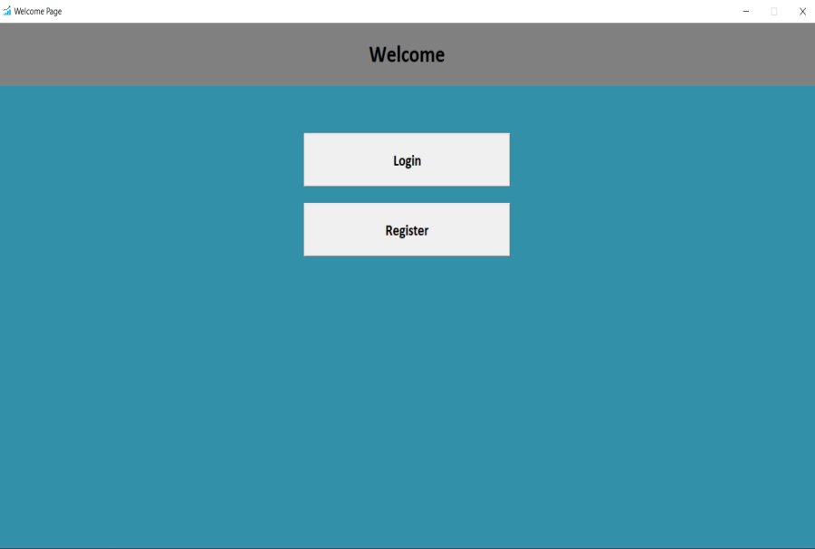
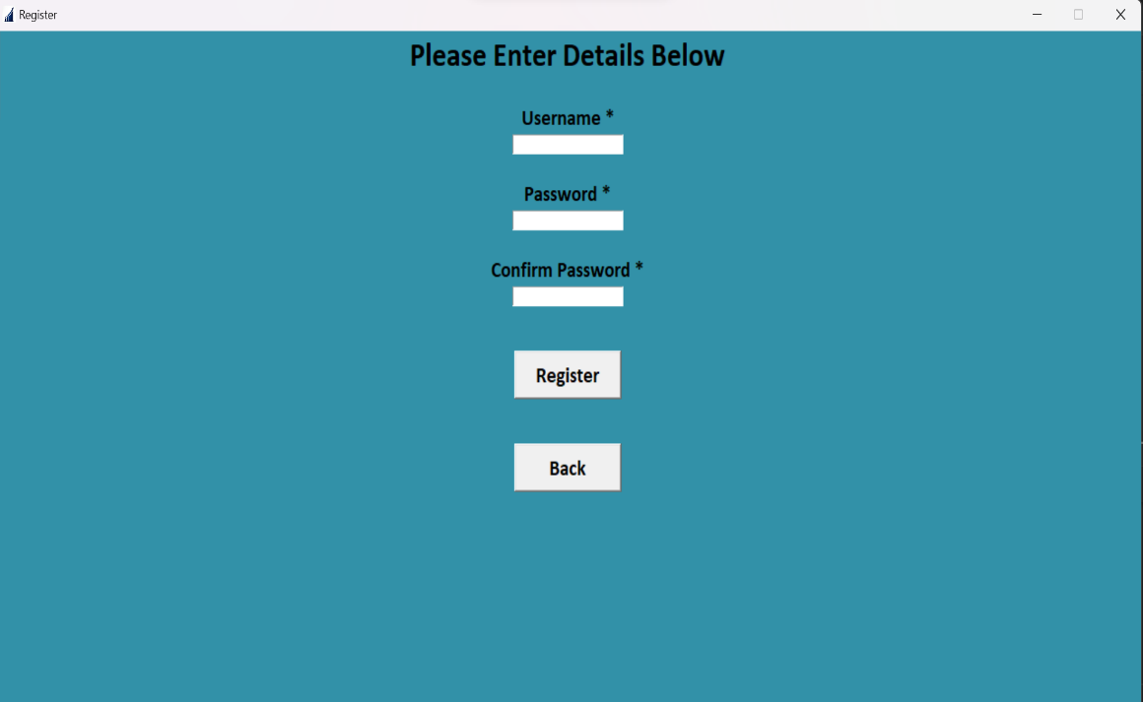
RESULTS
Welcome Page
Register Page

Slide 8
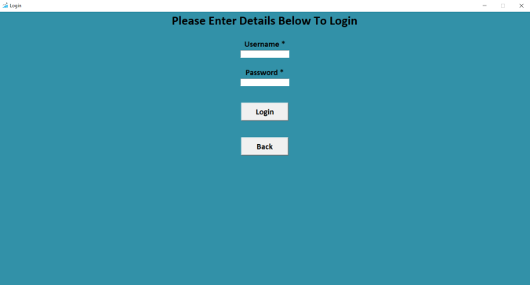
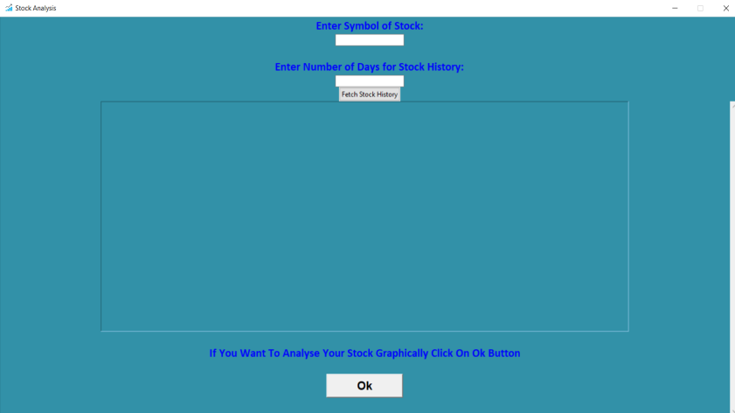
SCREENSHOTS
Login Page
Stock Page

Slide 9
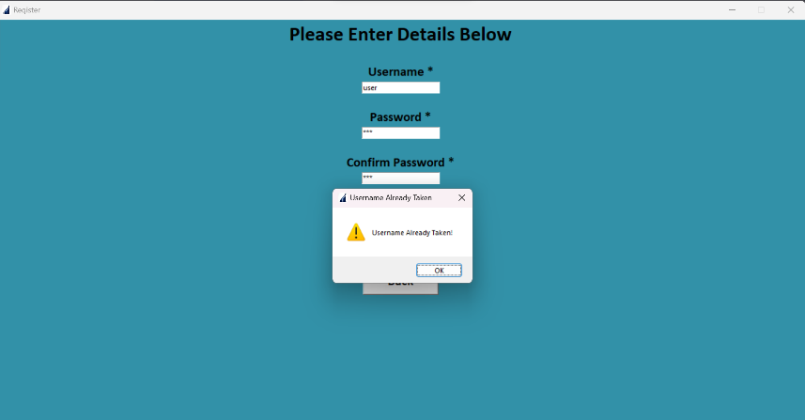
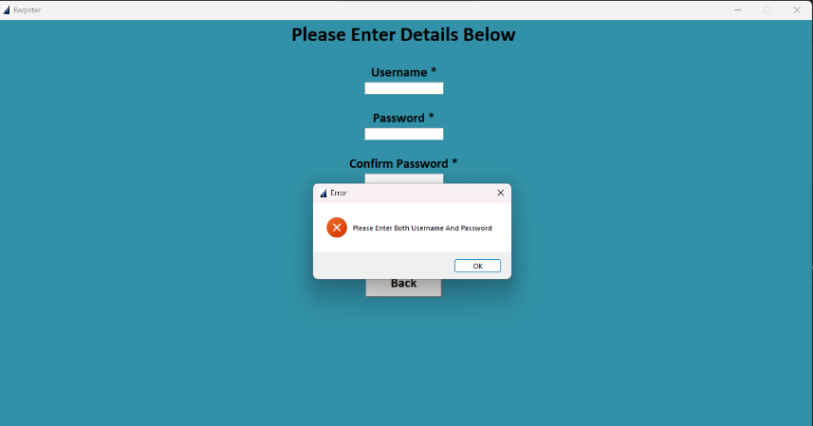
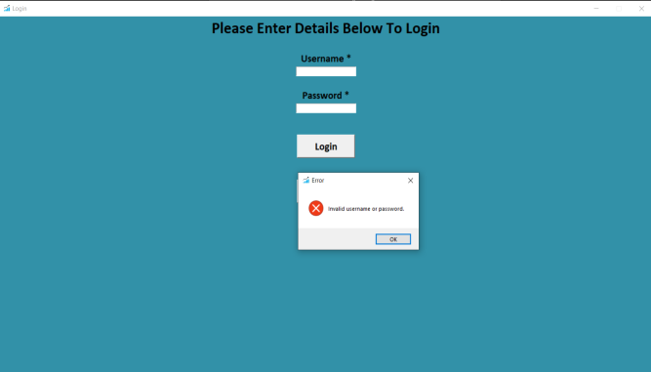
SCREENSHOTS – Exceptions Thrown During Login Or Register

Slide 10
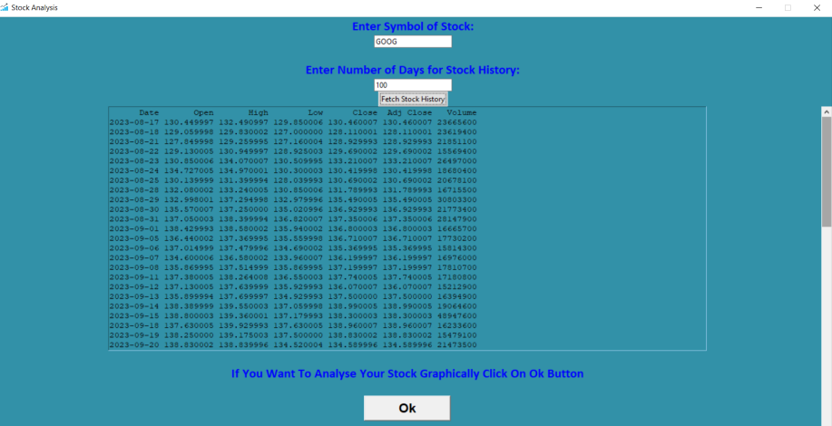
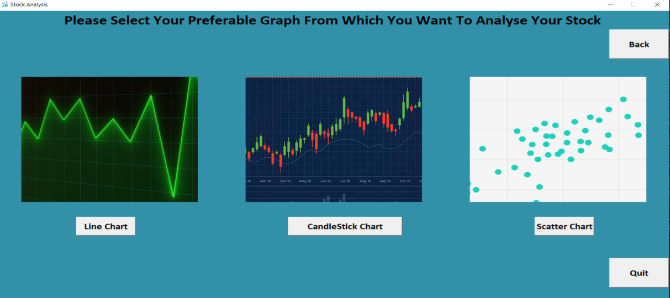
Stock data of Google for 100 days
Graph choosing page

Slide 11
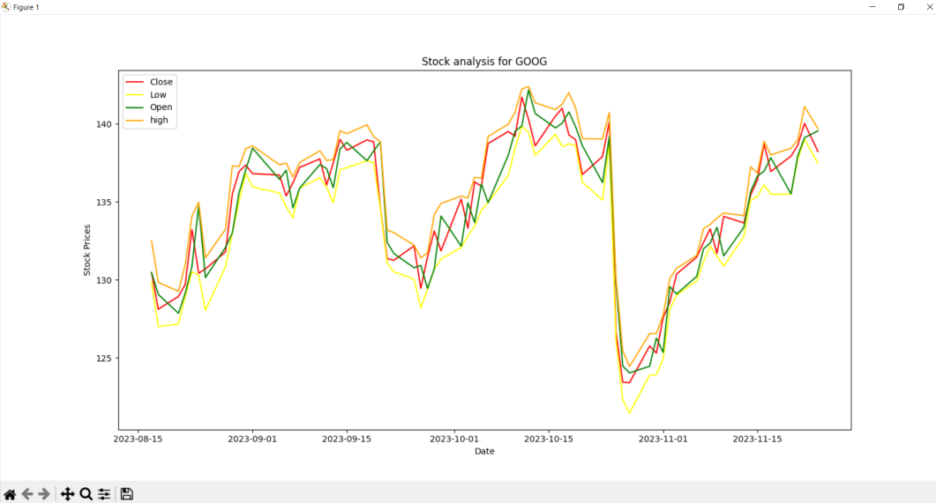
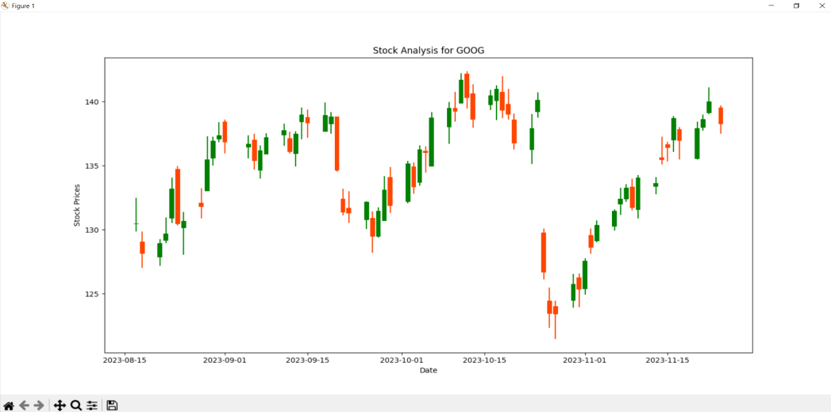
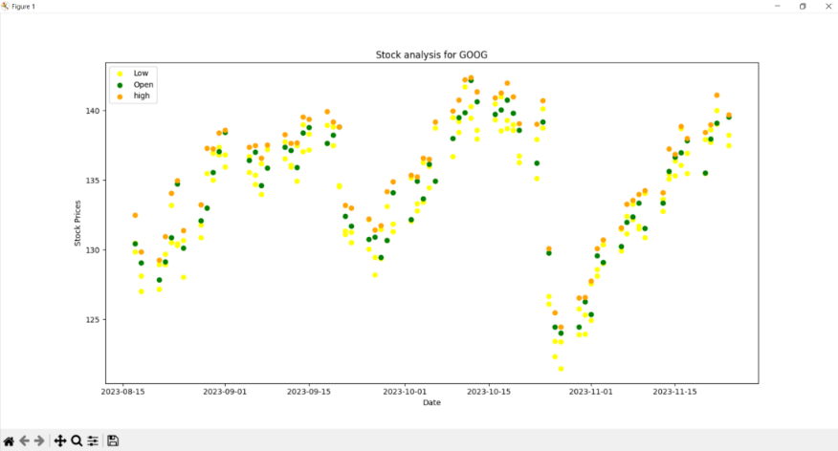
GRAPHS PLOTTED
Line Chart
Candlestick Chart
Scatter Chart

Slide 12
LEARNING FROM THIS PROJECT
Using yfinance to handle stock data.
Better understanding of graphical user interface.
Application of other python libraries like time, os and timedelta.
Using matplotlib to plot graphs.

Slide 13
CONCLUSION
This stock market analysis program offers a clear visual representation of crucial financial trends. This tool enhances understanding, aiding investors and analysts in strategic decision-making. By leveraging graphical insights, stakeholders can confidently navigate market complexities, identify opportunities, and mitigate risks, gaining a competitive edge in the dynamic world of finance.

Slide 14
REFERENCES
https://www.geeksforgeeks.org/
Python Documentation

